Slide 1
THE INNOVATORS PROGRAMME
@ YOUNG ADIPEC - Hall 15 3 – 6 Nov. 2025

Slide 2
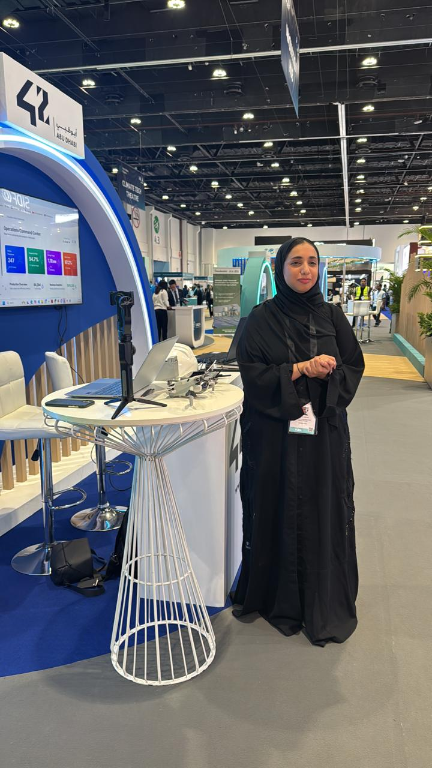
THE INNOVATORS PROGRAMME المُخْتَرِعُون
Through this exciting initiative, youth from all across the UAE—including university students and young innovators—are invited to take part in the Innovators programme, where groundbreaking energy-related research and ideas are showcased.
The Innovators Programme is designed to bring together the UAE’s talented young minds with industry leaders during the four dynamic days of ADIPEC. This initiative offers a unique opportunity to:
Present their innovations to industry leaders
Network with potential employers
Engage in meaningful exchanges of ideas with professionals and peers
Join us to be part of shaping the future of energy in the UAE!

Slide 3
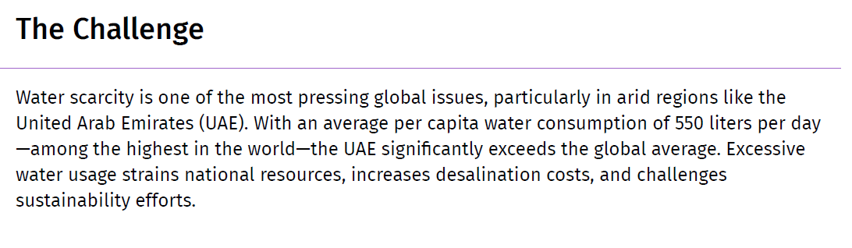
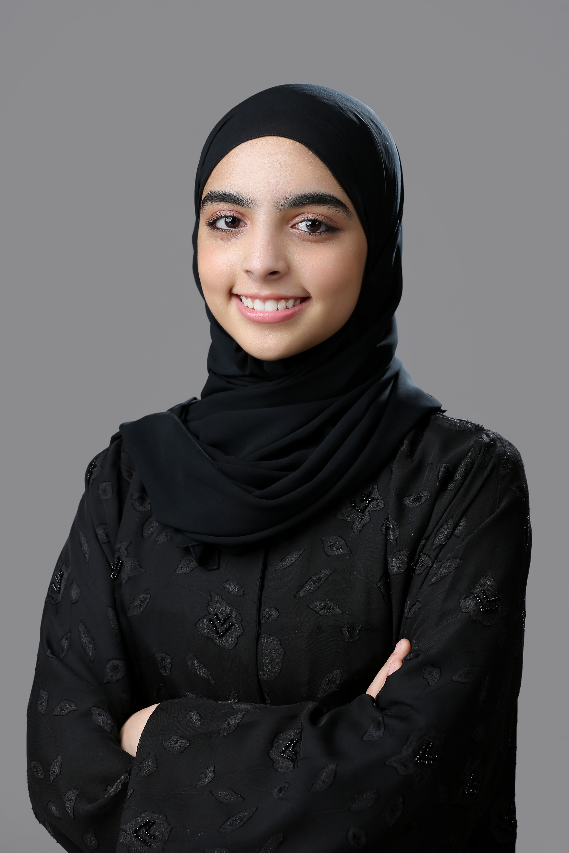
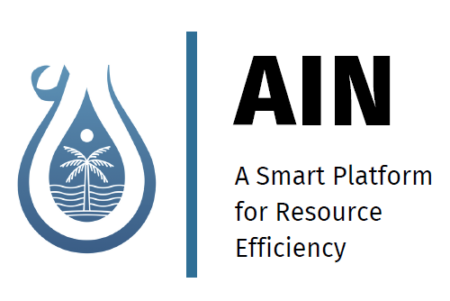
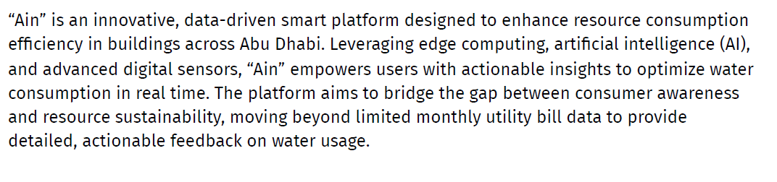
MEET THE INNOVATORS
Innovation show case daily during ADIPEC 2025 show days
Session Timing:
10:00
11:00
13:00
15:00
16:00
17:30
Alanood Alblooshi

Slide 4
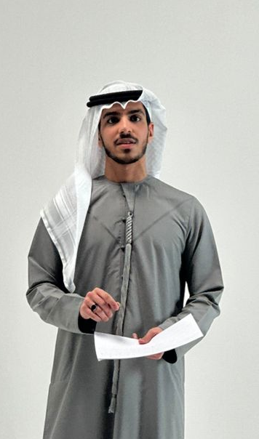
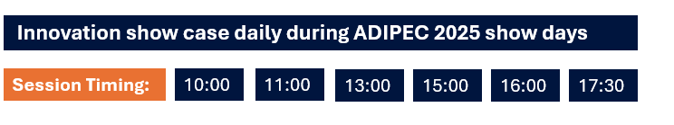
MEET THE INNOVATORS
Innovation: CloudHub
CloudHub represents a transformative approach to the hackathon ecosystem, positioning itself as the UAE's premier all-in-one platform that eliminates traditional barriers to organizing and participating in world-class hackathons. The platform addresses critical pain points in the current hackathon landscape by providing a comprehensive solution that spans the entire hackathon lifecycle—from initial concept creation to final prize distribution. At its core, CloudHub serves as both a community marketplace connecting thousands of innovators, developers, and visionaries, and a sophisticated management system that enables organizers to launch fully-functional hackathons in under 10 minutes. The platform's value proposition centers on removing the typical hassles associated with hackathon management, including complex registration processes, project submission workflows, judging coordination, and perhaps most critically, secure and transparent prize distribution.
Mohamed Al Mehairbi
Computer Science Student
Khalifa University

Slide 5
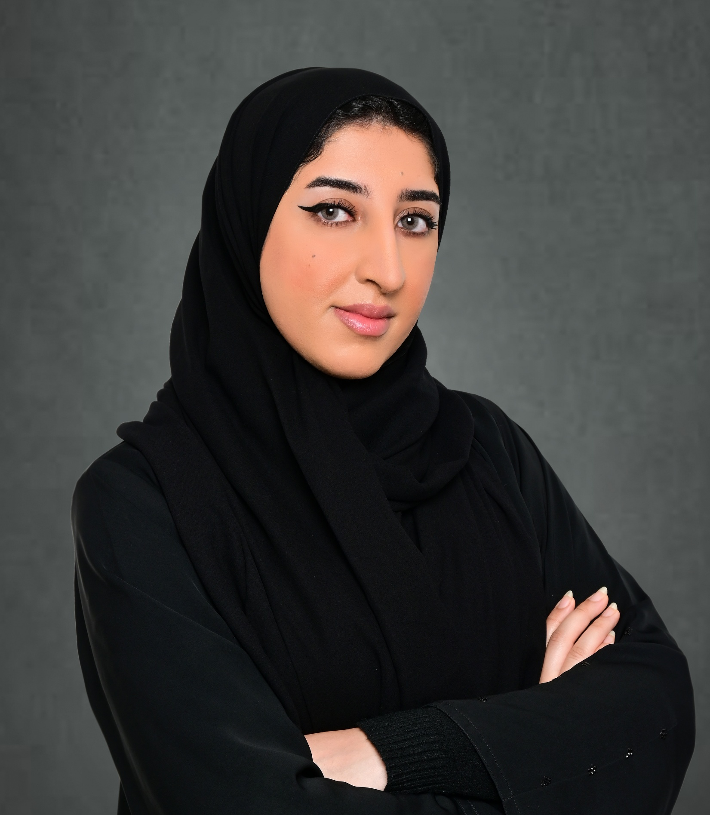
MEET THE INNOVATORS
Innovation: CoHub42
CoHub42 is an AI-powered startup platform based in the UAE that connects entrepreneurs with co-founders, investors, mentors, and resources. Our mission is to simplify the journey of building successful startups by offering intelligent matchmaking, tools, and strategic guidance—all in one platform.
Nouf Al Shibli
Information Security Specialist

Slide 6
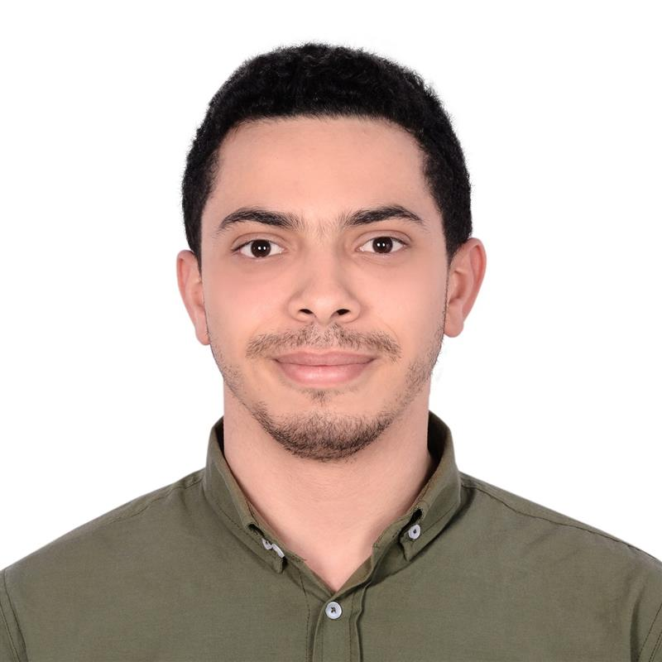
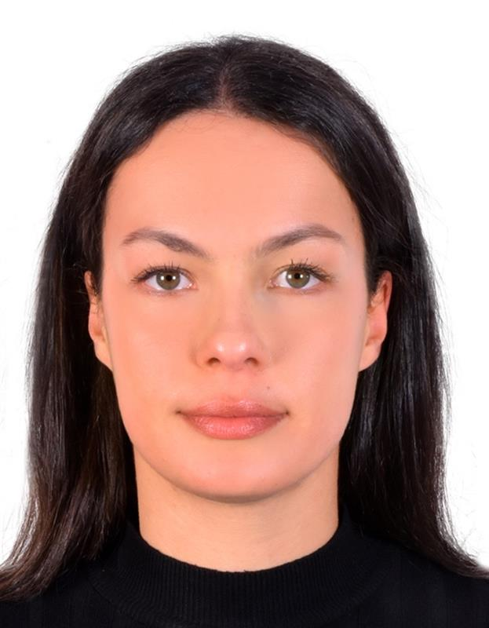
MEET THE INNOVATORS
Innovation: AI-Powered CPMS for Optimized Electrolyzer Monitoring
The Cell Performance Monitoring System (CPMS) is designed to monitor and optimize the performance of individual bipolar cell stacks within an electrolyzer. It shows high accuracy, real time tracking of critical parameters like voltage, temperature and insulation which helps detect imbalances, wiring faults, and early signs of degradation. By using AI driven predictive analytics, CPMS identifies performance trends, behaviour across multiple stacks, and supports the lifecycle analysis to suggest timed maintenance. This reduces downtime, minimizes unnecessary power consumption, and in general enhances electrolyzer efficiency while lowering reliance on the grid.
Ahmed Elyousfy
Robotics Engineer Broaden Energy
Sara Ayoub
Process Engineer Broaden Energy
Innovation show case daily during ADIPEC 2025 show days
Session Timing:
09:00
10:00
11:00
12:00
13:30

Slide 7
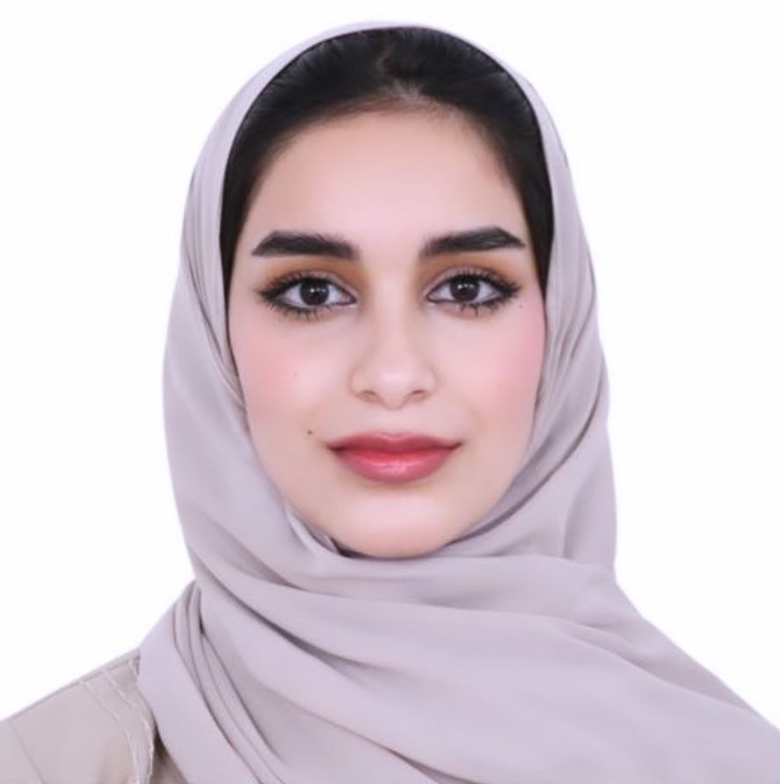
MEET THE INNOVATORS
Innovation: AS42 - Advancing Sustainable Biofuel Solutions for Space and Earth
AS42 is a youth-led research and innovation initiative focused on pioneering biofuel development as a clean energy alternative for both terrestrial and space-based applications. Under AS42, we unify a constellation of groundbreaking projects including Galactic Greens (space farming innovation) and ASBC (Astro-biological Solar Bioengineered Cells). At the core of AS42 lies a multi-year scientific endeavor into biofuel technologies, aimed at solving global energy challenges while enabling sustainable space exploration.
Mahra Mohamed AlNuaimi
Emirati Researcher, Innovator and Youth Leader
Innovation show case daily during ADIPEC 2025 show days
Session Timing:
14:00
15:00
16:00
16:30
17:00

