Slide 1


Name
Job Title
Company

Slide 2
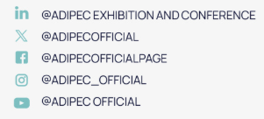
Name info sections are editable
To change photo right click the mockup image to change photo
Suggest caption
Our leadership will join global decision-makers at the ADIPEC Strategic Conference.
ADIPEC will provide a platform to examine how the industry can secure today’s energy, strengthen infrastructure and mobilise the capabilities needed for long-term growth. We are proud to contribute our perspective.
Explore the conference and book your delegate pass: https://bit.ly/4hD3Egb
#ADIPEC #ADIPEC2026
Follow and Tag ADIPEC

