Slide 1
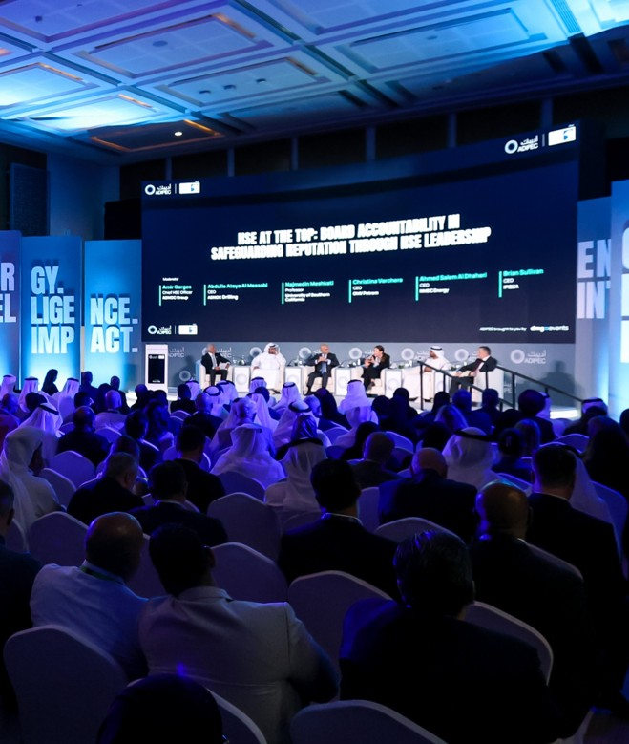



2-5 November 2026, Abu Dhabi, UAE
ADIPEC 2026
Technical Programme
Technical programme organised by
ADIPEC brought to you by

Slide 2



PAPER TITLE
PAPER NUMBER
NAME OF SPEAKER
Technical programme organised by
ADIPEC brought to you by

Slide 3
TEXT
Secondary text
Text
Technical programme organised by
ADIPEC brought to you by

Slide 4
TEXT
Secondary text
Text
Technical programme organised by
ADIPEC brought to you by

Slide 5

TEXT
Secondary text
Text
Technical programme organised by
ADIPEC brought to you by

Slide 6
Tips for Making Effective PowerPoint Presentations
Simplify and limit the number of words. Avoid long sentences.
To test the font, stand back six feet from the monitor and see if you can read the slide. Use font size 18 or larger.
Select sans-serif fonts such as Arial or Helvetica. Avoid serif fonts such as Times New Roman or Palatino as they are sometimes more difficult to read.
Limit punctuation and avoid putting words in all-capital letters. Empty space on the slide will enhance readability.
Use good-quality and visually appealing images such as charts, graphs, sketches, and animation that reinforce and complement your message. Ensure that your image maintains its impact and resolution when projected on a larger screen. Avoid screenshots.
Keep in mind the time limit for your presentation. A good rule of thumb is 1 slide per minute.
Check the spelling and grammar.
Do not read the presentations. The content of your slides is for the audience, not for the presenter.
Do not speak to your slides. Many presenters face their presentation onscreen rather than their audience.
No commercialism within the content of the presentation – trade names, company names and logos are not allowed.
Ensure the content of the presentation aligns with your manuscript.
Technical programme organised by
ADIPEC brought to you by

Slide 7
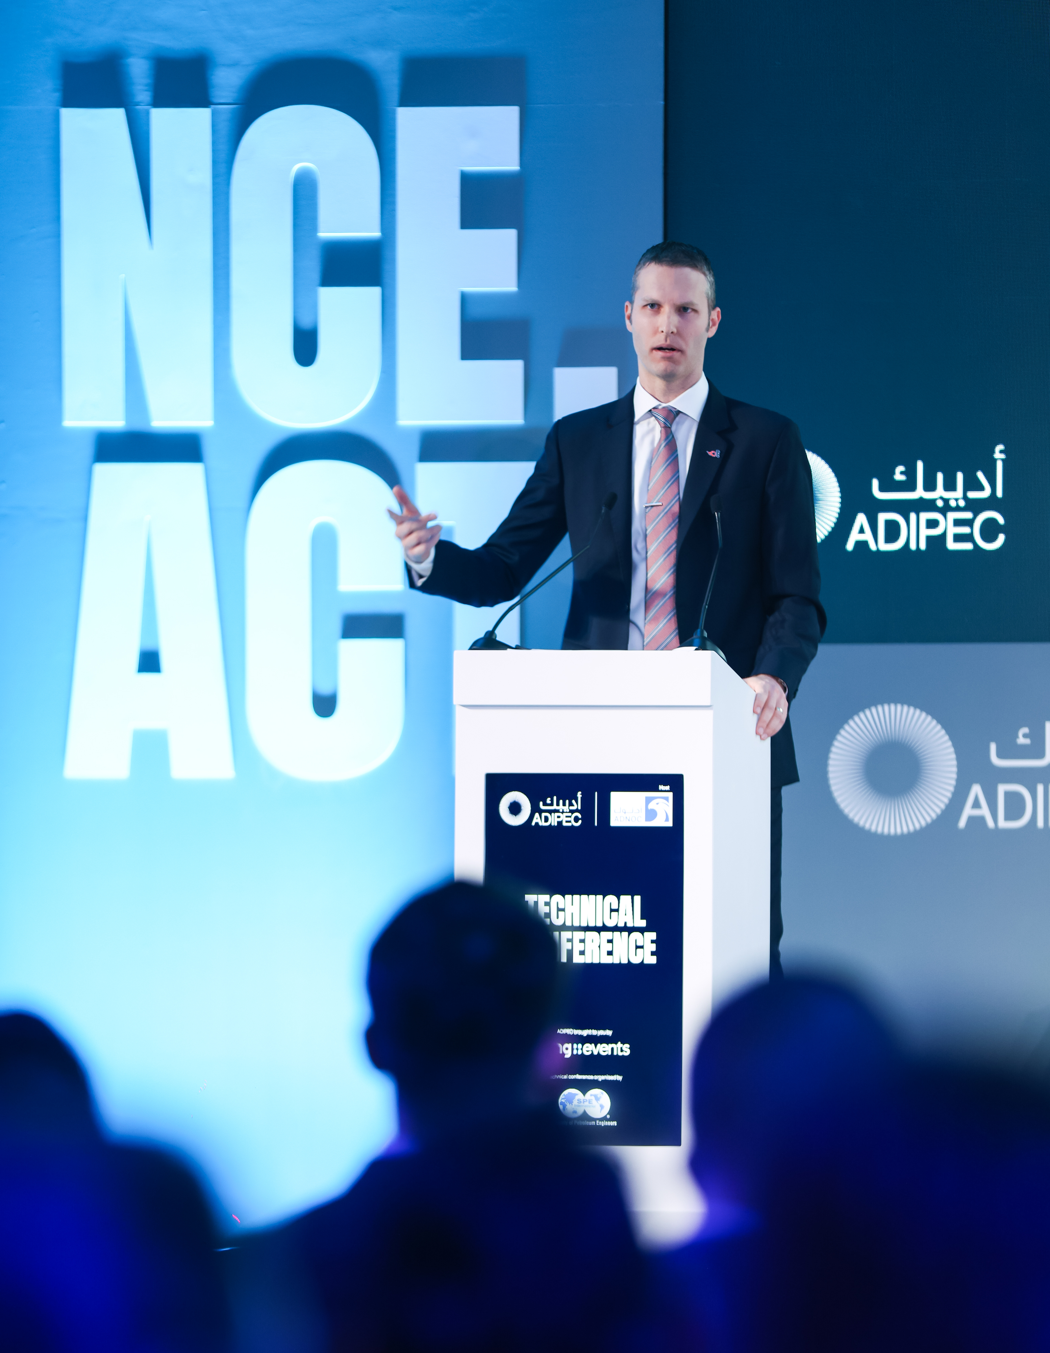
2-5 November 2026, Abu Dhabi, UAE
THANK YOU
Technical programme organised by
ADIPEC brought to you by

